Slide 1
Predicting Machine Failure
By: Yee Hang

Slide 2
Objectives
Objective: To develop a classification model with high sensitivity (recall) to predict whether a machine is in working condition or faulty condition
The average cost of lost revenue and idle staff due to unplanned downtime machine failure is $ 532,000 per hour which is $ 172 million per plant annually. https://www.automation.com/en-us/articles/june-2021/world-largest-manufacturers-lose-almost-1-trillion

Slide 3
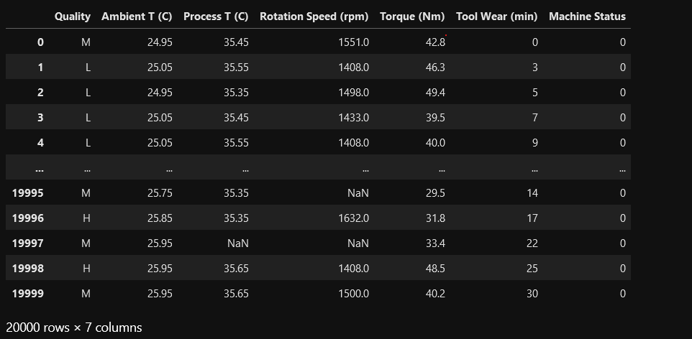
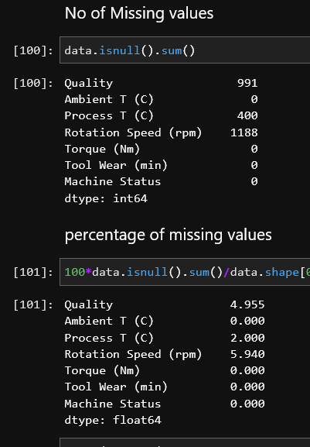
Dataset Info
There are 20000 records and 6 features and the target variable (PC Price in $)
2) Null values exist in Quality , Process Temperature and Rotation speed
3)Hence , We will carry out imputation first for easy eda and analysis further on

Slide 4
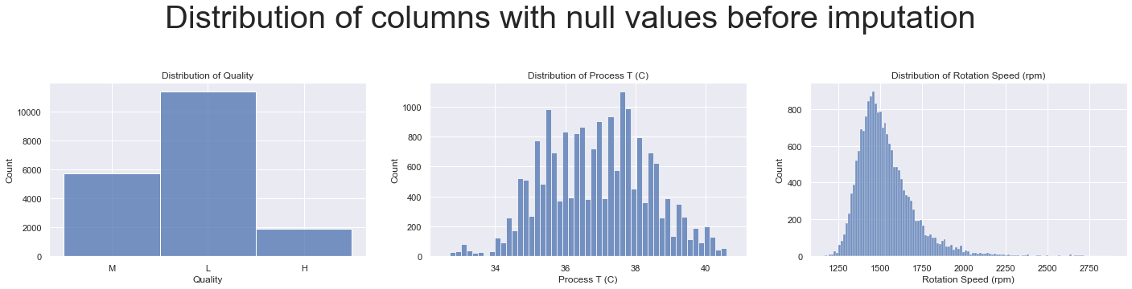
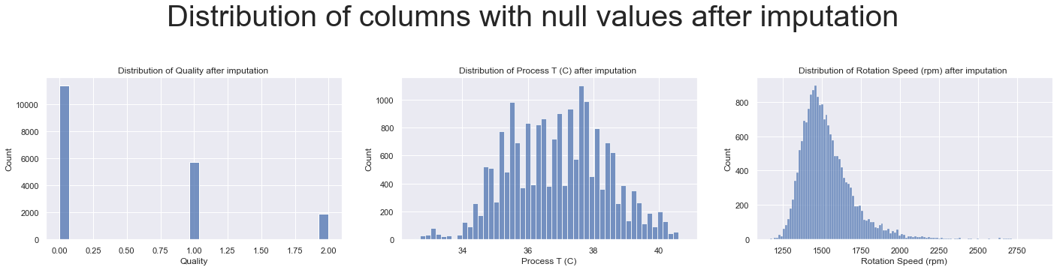
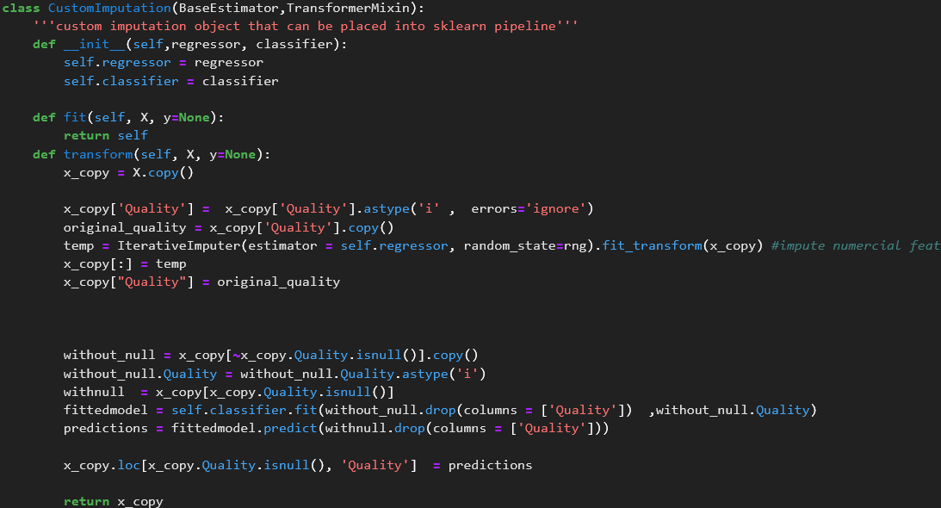
Imputation
These are the existing distributions of these features with null values. - Attempt to impute that does not the alter the distribution Mean/median/mode Imputation will not be accurate as the distributions are not gaussian (positively skewed distribution of rotation speed)
- Multivariate distribution is better for imputation
Distribution is unchanged by imputation

Slide 5
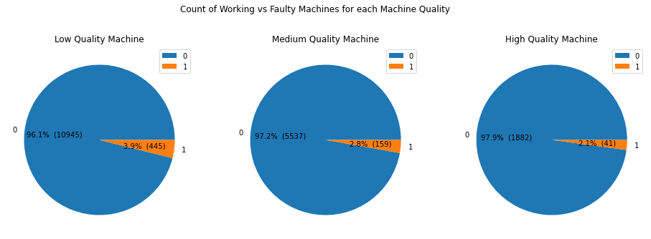
EDA
Phik Correlations
Unbalanced classes
This dataset has unbalanced classes , (a lot of negative examples , very little positive examples) , which means accuracy as scoring metric cannot be used for modelling later (more on metrics below)
Unbalanced classes should be deal with during modeling later
Quality vs Machine Status
Machines with higher quality have slightly larger percentages of machines that are faulty , which are 2.1% , 2.8% and 3.8% for High , medium and low quality machines respectively ,
As the percentages are similar, it is difficult to tell whether there is an association between quality and machine status,
hence, chi square test at significance level of 5% is used to verify whether such relationship exists

Slide 6
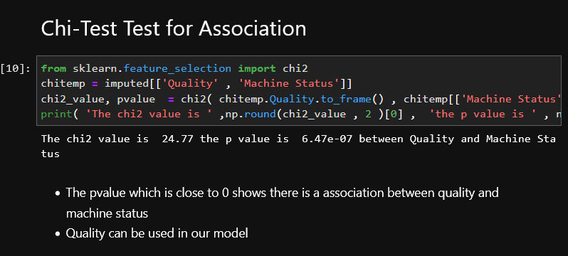
EDA
Chi-Test Test for Association
The pvalue which is close to 0 shows there is a association between quality and machine status
Quality can be used in our model

Slide 7
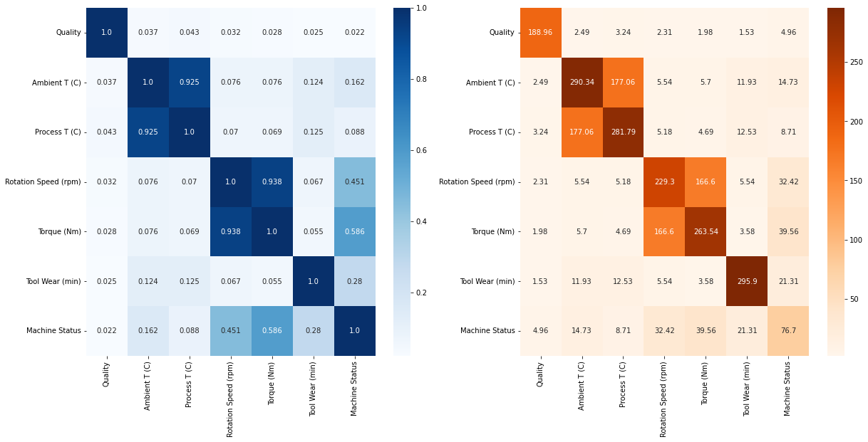
EDA
Phik Correlation
Correlation between Features
Most features are independent (not correlated) of each other
There are 2 sets of features that are highly correlated with each other significantly
process (T) and ambient (t)
Torque and Rotation Speed
Highly correlated features (Multicollinearity) decreases the accuracy of distance based models like K nearest neighbours, logistic regression , neural network
Hence, they must be tranformed by PCA or one feature from each pair of multicollinearity must be removed
Correlation between features and price
Torque and Rotation speed most correlated with the Machine Status with correlation 0.58 of and 0.45
Correlation between Machine status and process t, ambient t , Tool Wear is weaker at 0.162, 0.088 and 0.28 respectively. These features should still contribute to the model hence they cannot be dropped. Dropping them would cause model to severely underfit

Slide 8
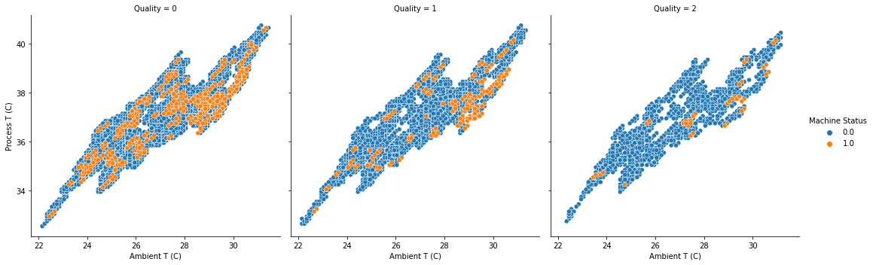
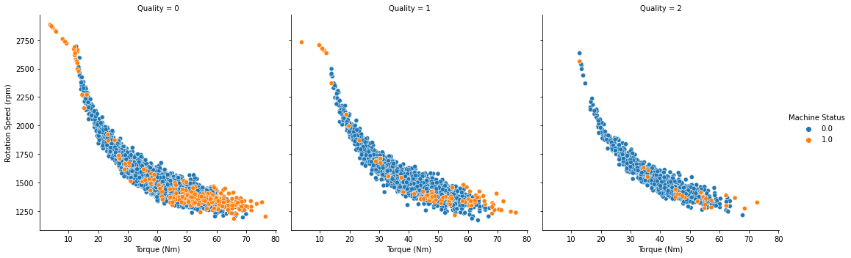
EDA
These 2 pair of features of rotation speed and torque and (ambient and process temperature) are highly correlated with each other
PCA can be used to transform each pair of features highly correlated with each other to create principle components that are orthogonal to each other ( thus removing the multi collinearity)
There are presence of outliers for torque and rotation speed , but these are faultly machines
With these 3 features alone, the faulty and non faulty machine are not well separated, (ie. the blue and orange data points are overlapping each other)
more features are needed to predict machine status

Slide 9
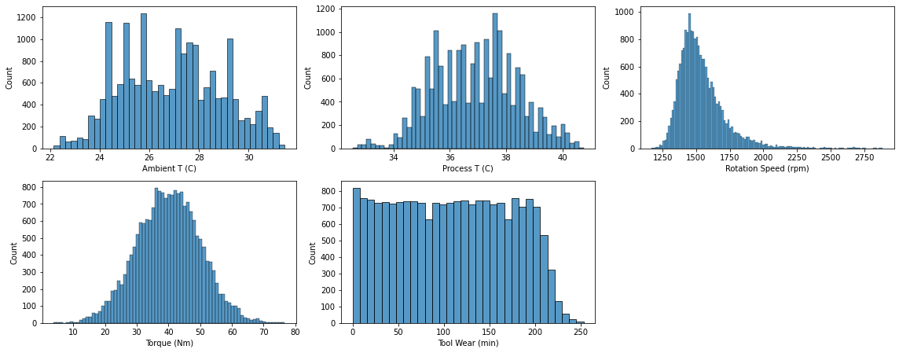
EDA - Choosing a scaling method
StandardScaler() should not be used as rotation speed contains outliers, ie (the z score from standardscaler does not apply to non normal distributions)
Hence, robust scaler should be used as it handles outliers well

Slide 10
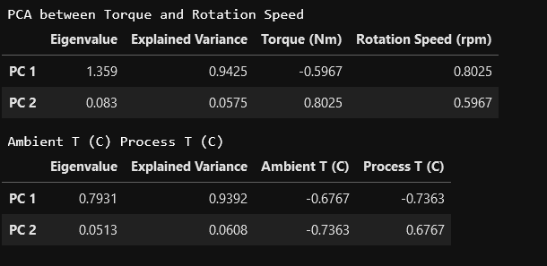
Preprocessing - PCA to minimize multicollinearity
We keep the first PC of each PCA as the second componenet only captures 5 or 6% of the total variance, hence the second components are most likely noise that likely to cause overfitting

Slide 11
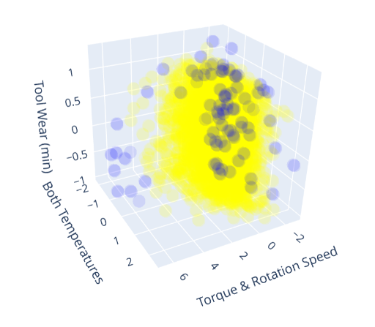
Further EDA -
Yellow – Working Blue - faulty
The 2 principle components and the tool wear feature is plotted on 3d scatter plot
On the left side the positive data points (faulty) are somewhat separated from the negative ones. However, a lot of positive points are still overlapping with the negative points points on the right

Slide 12
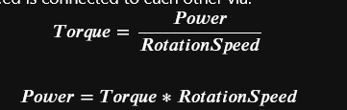

Feature engineering
Feature Engineering creates new features from existing features
It provides more information to the model, thus making it 'easier' to predict machine status
From: https://byjus.com/physics/relation-between-torque-and-speed/
Machines that are overheating are more likely to be breaking, hence a large difference between the process temperature (operating temperature) and ambient temperature (temperature of the machine not operating)
Total number of revolutions machine has gone through also important

Slide 13
Further EDA -
Correlations exist between machine status and the power, temperature different and no of revolution
Hence, they might be useful to the model

Slide 14
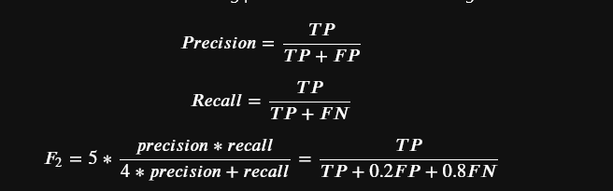
Metric
Lots of money is lost when machines breakdown
Hence the model must be sensitive in identifying all faulty machines as faulty
It is worse to misclassify faulty machines as working machines than misclassifying working machines as faulty , as faulty machines causes great economic damage
Hence, recall scores are more important than precision
The model must also be precise as identifying too many correct machines as faulty would waste money in developing the machine also
Hence f2 score is used to put more weight on recall while not ignoring precision

Slide 15
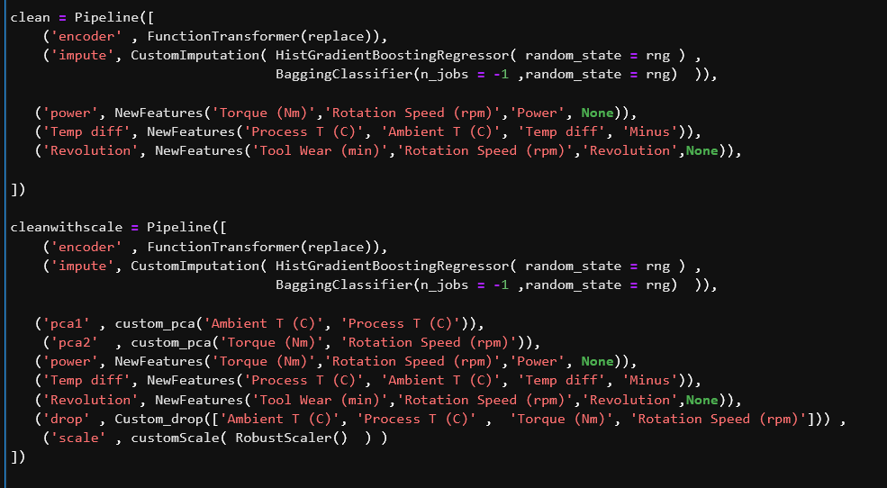
Pipeline
Most Preprocessing such as Ordinal encoding, imputation is placed in the Pipeline to prevent any data leakage
the clean pipeline used for models that are scale invariant and models that not affected by multicollinearity. For e.g DecisionTree and RandomForest
the cleanwithscale pipeline usef for models that are scale invariant and models that are affected by multicollinearity for e.g NeuralNetwork and KNN

Slide 16
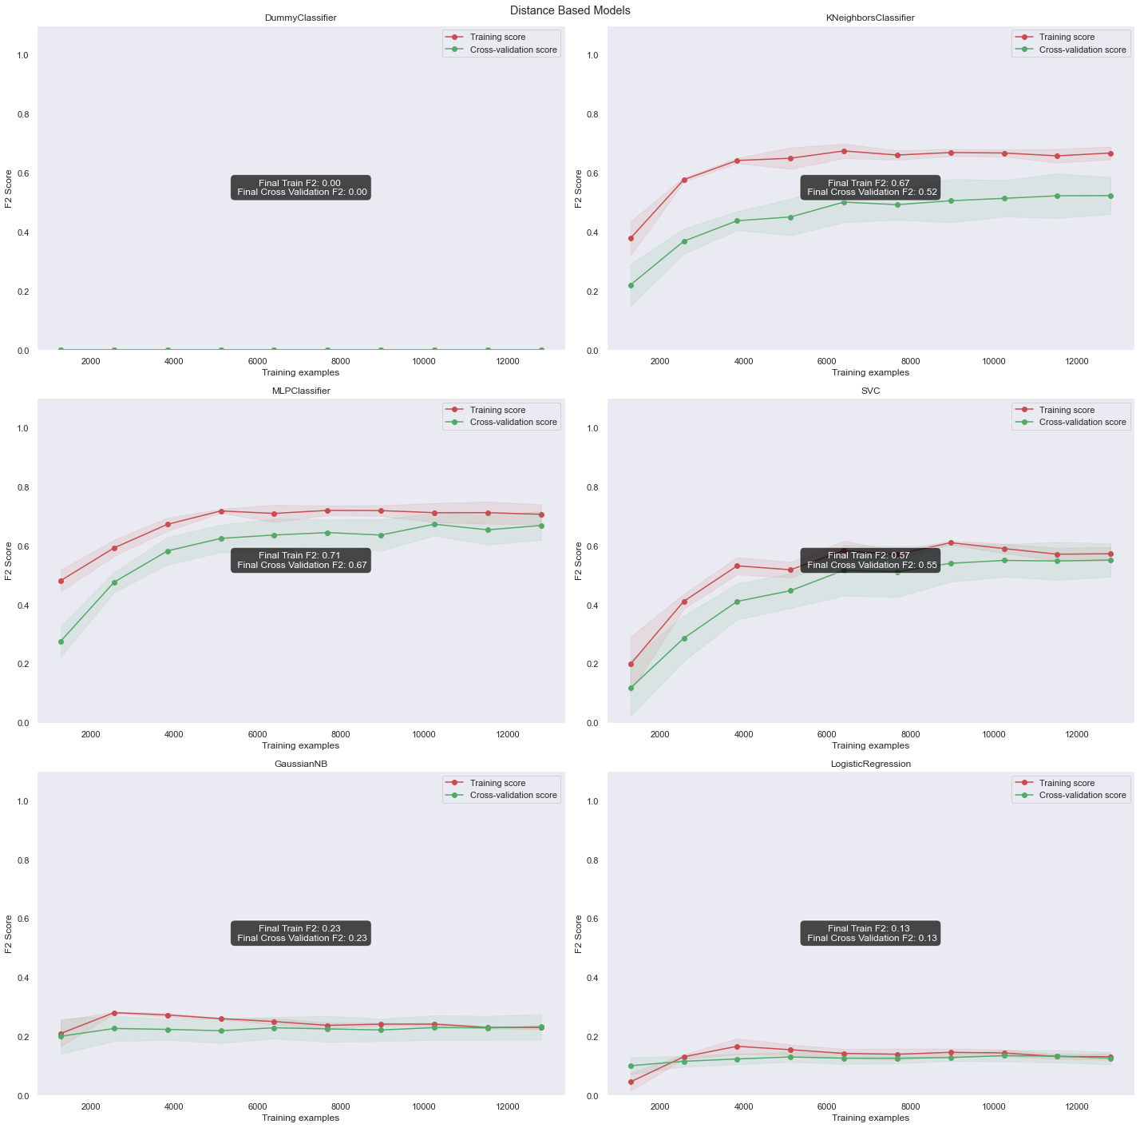
Modelling – Model Choosing (Non Ensemble)
- These models generally suffer from high bias
DummyClassifier
performs very poorly with an f2 score of 0, as it simply predicts all machines to be working, leading to recall of 0 (hence f2 = 0) as none of the faulty machines (true positive) is predicted as positive
KNeighbours
F2 score increases initially but pleateau out quickly at around 0.5 and 0.6 for cross validation and train set respectively
Neural Network
Slightly better than KNeighbours but still underfitting
SVM
Underfitting with poor final cv score
GaussianNB
LogisticRegression
consistently low f2 score for both Gaussian NB and Logistic Regression

Slide 17
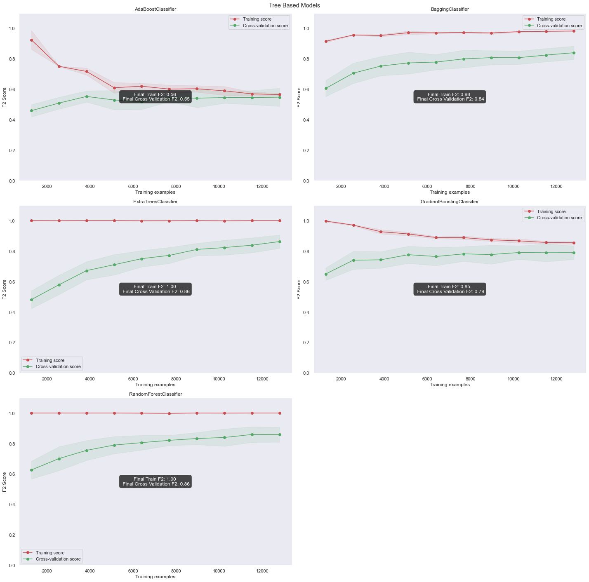
Modelling – Model Choosing (Ensemble)
Slightly overfitting models
Extra Trees
Bagging
Random Forest
Random Forest is chosen as it has the highest f2 score

Slide 18
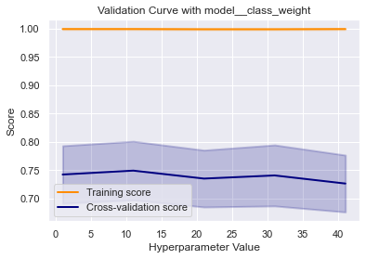
Model Improvement
- Attempt to place more weights on the rarer class (positive class/faulty machines ), so that theres is lower chance of misclassifying faulty machine on the lower class
- Despite Putting more weights on the positive examples (which are more rare) the model did not improve and the model is overfitting even more as the weight placed on the positive class increases

Slide 19
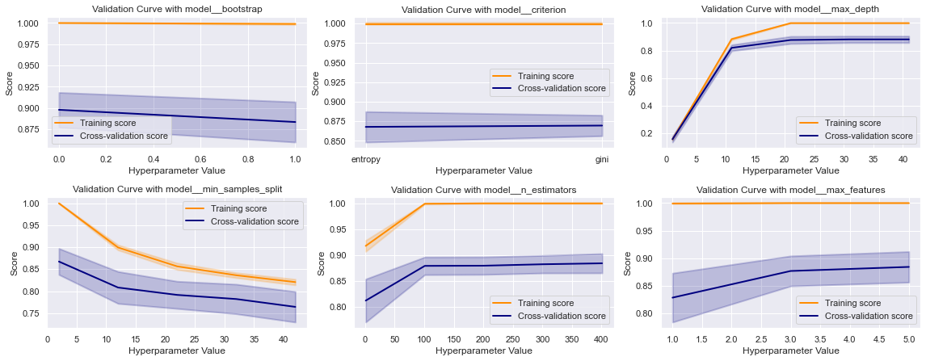
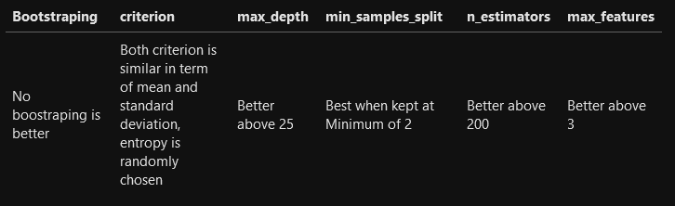
Model improvement – Validation Curve
- Hyperparameters controls the bias variance trade off
These are how they affect Random Forest in General
- max_depth : higher depth leads to more variance and less bias (less underfitting)
- min_sample_split : Larger minimum number of samples required for a split leads to more bias and less variance (less overfitting)
- n_estimators : more estimators (decision trees) would average out the errors made by each estimator due to high variance of each individual decision tree, more estimators leads to lower variance higher bias

Slide 20
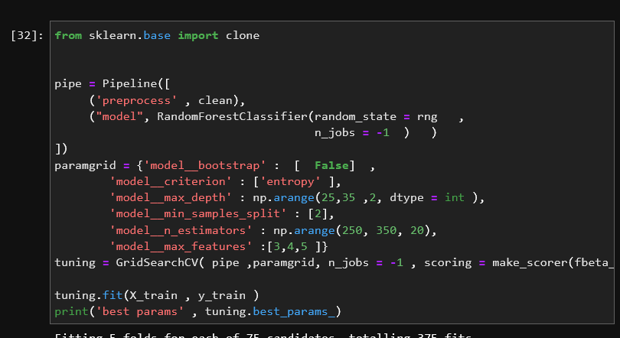
Model improvement – Hyperparameter Tuning
New hyperparameters are found which is different from the default values

Slide 21
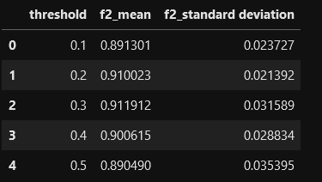
Model improvement – Threshold moving
- The Random Forest output the probability that a machine is faulty
- The model then uses the default threshold 0.5
- This threshold control precision recall tradeoff
- i.e (if the output probability is > 0.5 the machine is considered faulty and not faulty if output probability < 0.5 ). The default threshold places equal importance on recall and precision )
- Threshold < 0.5 mean it is more important to correctly identify that most/all machines that are faulty are predicted as faulty, thus favouring better f2 score
- alter the threshold of the model as lower thresholds (0.1, 0.2 , 0.3 , 0.4 ) below 50 will favour better f2 score
- Lowering the threshold has improved the f2 cross validation scores
Threshold of 0.3 is chosen for its best f2 score

Slide 22
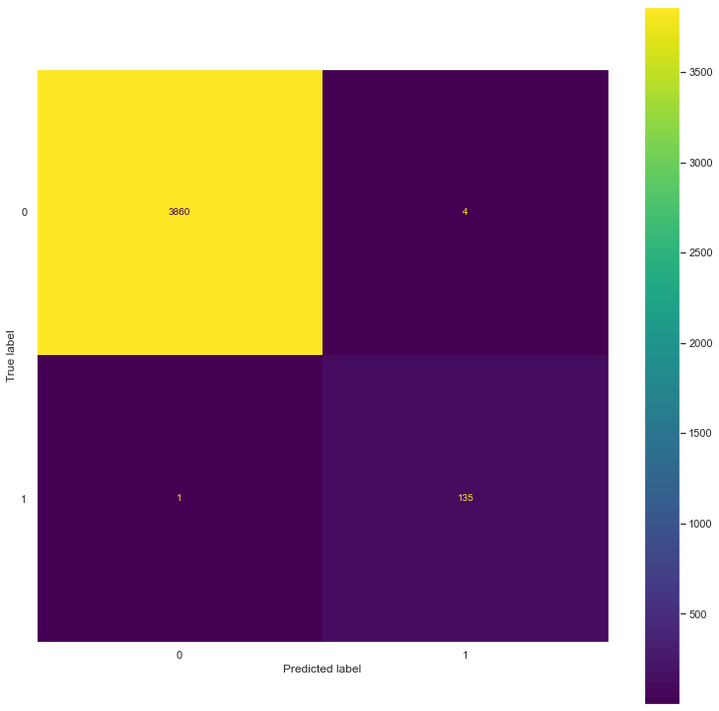
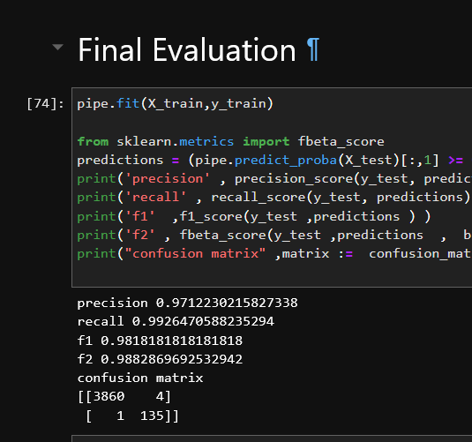
Final Evaluation
We achieved f2 score of 0.988, recall of 0.992 and precision of 0.971
There is 1 machine that is predicted as faulty but predicted as not faulty
4 Machines that are not faulty that are predicted as faulty

Slide 23
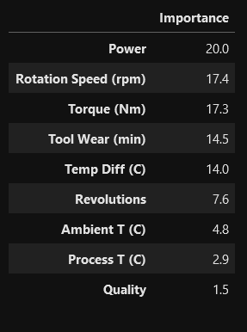
Feature Importance
- The Feature importance's show the most important feature is Power from feature engineering, taking up 20% of the total importance. Its phik correlation with price is 37.59 while that of torque is 0.586 showing the relationships found by the rule based RandomForest is nonlinear (phik correlation only detects linear relationships)
- Temperature difference has importance of 14% while the ambient and process temperature only has importance's of 4.8% and 2.9%, thus showing how feature engineering by creating new features, helps the model in predictions
Conclusion
Through EDA, feature engineering , model choosing and hyperparameter tuning, we have created a model that is sensitive enough to identify all the faulty machine, while also quite precise that quite little machines that are not faulty are identified as faulty. Hence, our model should be able to save some cost for the company by fixing the identified faulty machines before they actually malfunction

